Slide 1
Quiz

Slide 2
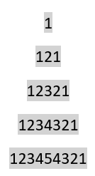
Try to solve this tasks
Write C code to calculate the factorial of n.
Write C code to print the following using loop.
Write C code to print the n terms of the following series:
0,1,1,2,3,5,……………………

Slide 3
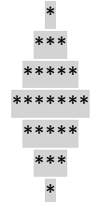
Try to solve this tasks
Write C code to print the max out of 4 Numbers.
Write C code to print the following using loop.
Write C code to print the n terms of the following series:
0,1,1,2,3,5,……………………

